Slide 1
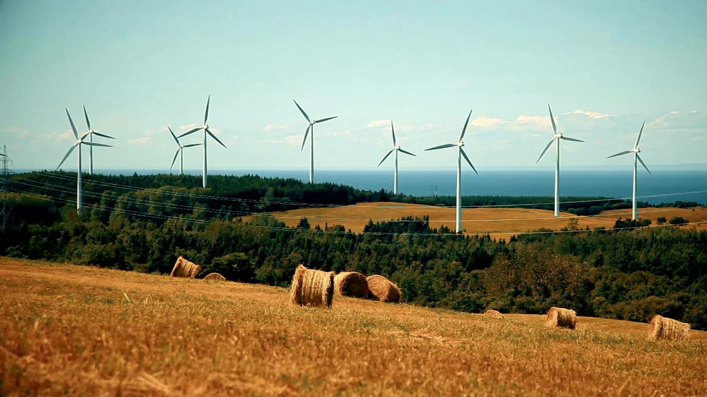
BP Wind Sim
CMPSC:
Bert Yan
Shuaipeng Dong
David Rohrbaugh
Nelloe Anonyuo
Seyilayo Olagbami
MechE:
Scott Carroll
Marissa Stecko

Slide 2
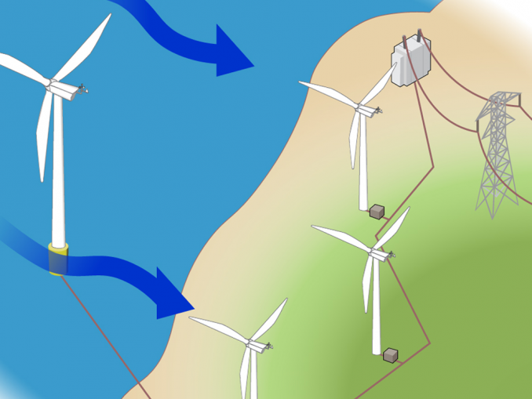
Turbines operate facing the wind
Turbines blades are airfoils – designed to catch and redirect air when the hub of the turbine is perpendicular to the direction of airflow
Yaw motors can rotate the hub when wind directions change
Turbines can be on-shore (land) or off-shore (ocean)
https://www.rechargenews.com/wind/will-wind-wake-slow-industrys-ambitions-offshore-/2-1-699430

Slide 3
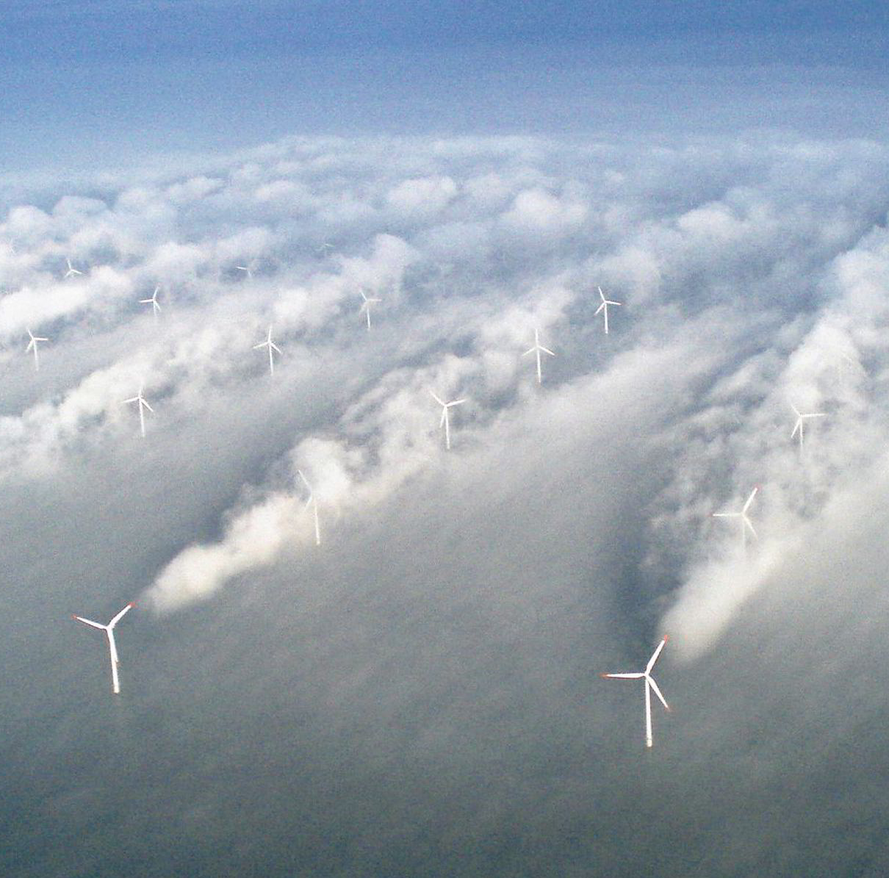
Wind turbines produce wake:
https://www.rechargenews.com/wind/will-wind-wake-slow-industrys-ambitions-offshore-/2-1-699430?zephr_sso_ott=RVsTDE
Wind fields are planned in simulation before being built
Leading wind turbines produce a wake that impacts the turbines behind it – reducing efficiency of the wind farm
Grid layouts help with planning to minimize wake effects
Experimenting with the angle of attack between the turbine and the wind may also help with efficiency and wake effects

Slide 4
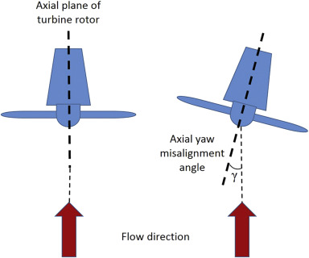
Adjusting the angle of attack will change the wake produced by the turbine.
Changing the angle of attack will place increases stresses on the turbine and may shorten the mechanical life of the structure.
https://www.sciencedirect.com/science/article/pii/S0960148117304081

Slide 5
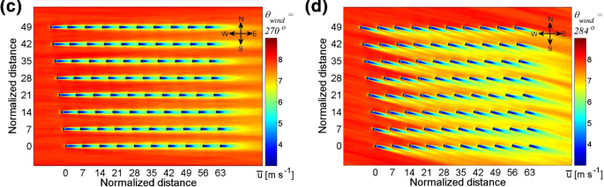
This change in wake pattern may prove to be helpful in optimizing energy output of windfarms.
https://link.springer.com/article/10.1007/s10546-019-00473-0

Slide 6
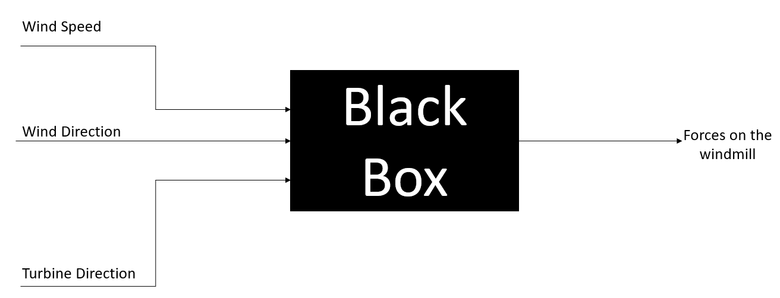
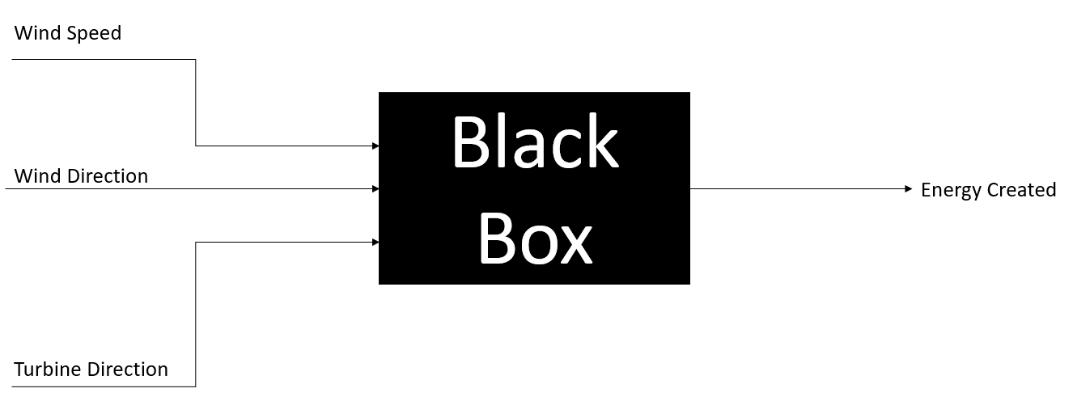
Our Project Objective:
Forces on a Turbine
To create a program that allows for the simulation and optimization of windfarms based on user-defined settings.
Example Inputs:
x-,y- and z- locations of a wind turbine in a wind field
Wind inflow conditions (speed and direction)
Turbine height
Yaw misalignment
Example Outputs:
Energy output
Turbine wakes
Forces on a turbine and effects on mechanical life
Energy Output of a Turbine

Slide 7
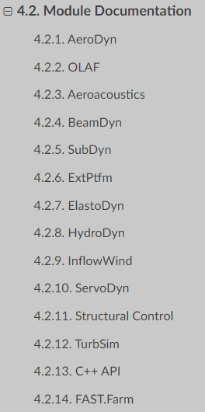
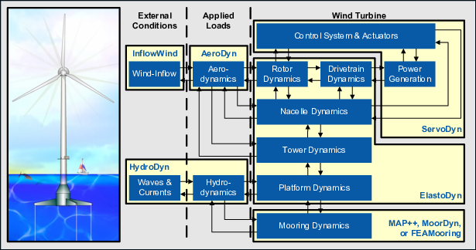
Potential Solutions – OpenFAST
An open-source wind turbine simulation tool/framework.
Maintained and developed by the National Renewable Energy Laboratory (NREL) since 2017.
Glue code and underlying modules are written in Fortran (2003 standards), recent modules used C++.
13 Modules readily available to test inputs on (Most are out-of-scope for the project).
One of the most documented and implemented framework for wind renewable energy researches.
Sophistication of the framework presents a steep learning curve.

Slide 8
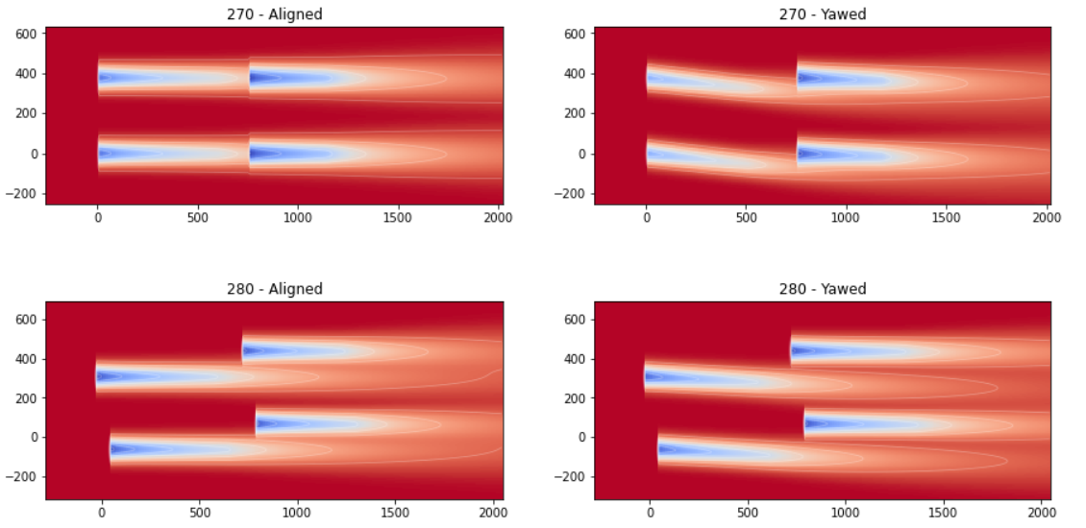
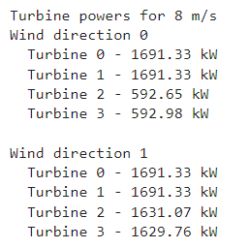
Potential Solutions –Floris
Floris uses a steady state engineering wake model and it is built in a python framework. It has been in development since 2013 from the National Renewable Energy Laboratory.
Floris takes in an array of parameters such as wind directions, wind speeds as well as various atmospheric conditions such as air density, turbulence intensity and various parameters relating to the wake and how it is affected by the wind turbines.
The main outputs are the annual energy output of a given wind farm and a visualization of the wake produces by the wind turbines
Floris can also apply a wake steering algorithm that will optimize the yaw angle of the wind turbines to minimize the impact the wake has on the wind farm.

Slide 9
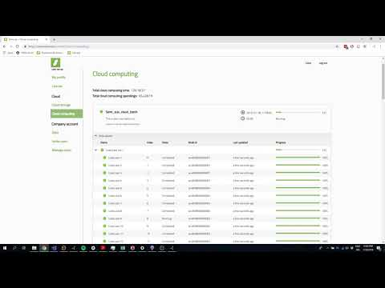
Potential Solutions –Ashes
Ashes which stands for aero-servo-hydro-elastic simulation is a Wind turbine simulation software developed by Simis.
Ashes is a software that performs integrated analyses of onshore and offshore wind turbines. The script for the software is written in Python. It provides a set of built-in templates that enables you to quickly create a wind turbine model which can be further customized.
Ashes visualizes wind and wave loads and the resulting response of the wind turbine in a live, real-time manner during simulations. At any time, the simulation speed can be increased or decreased, and different parts can be studied close-up.
Data generated during the simulation is gathered in a collection of sensors, where each individual time series can be viewed live in graphs.

Slide 10
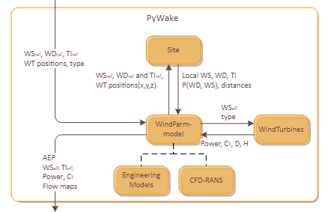
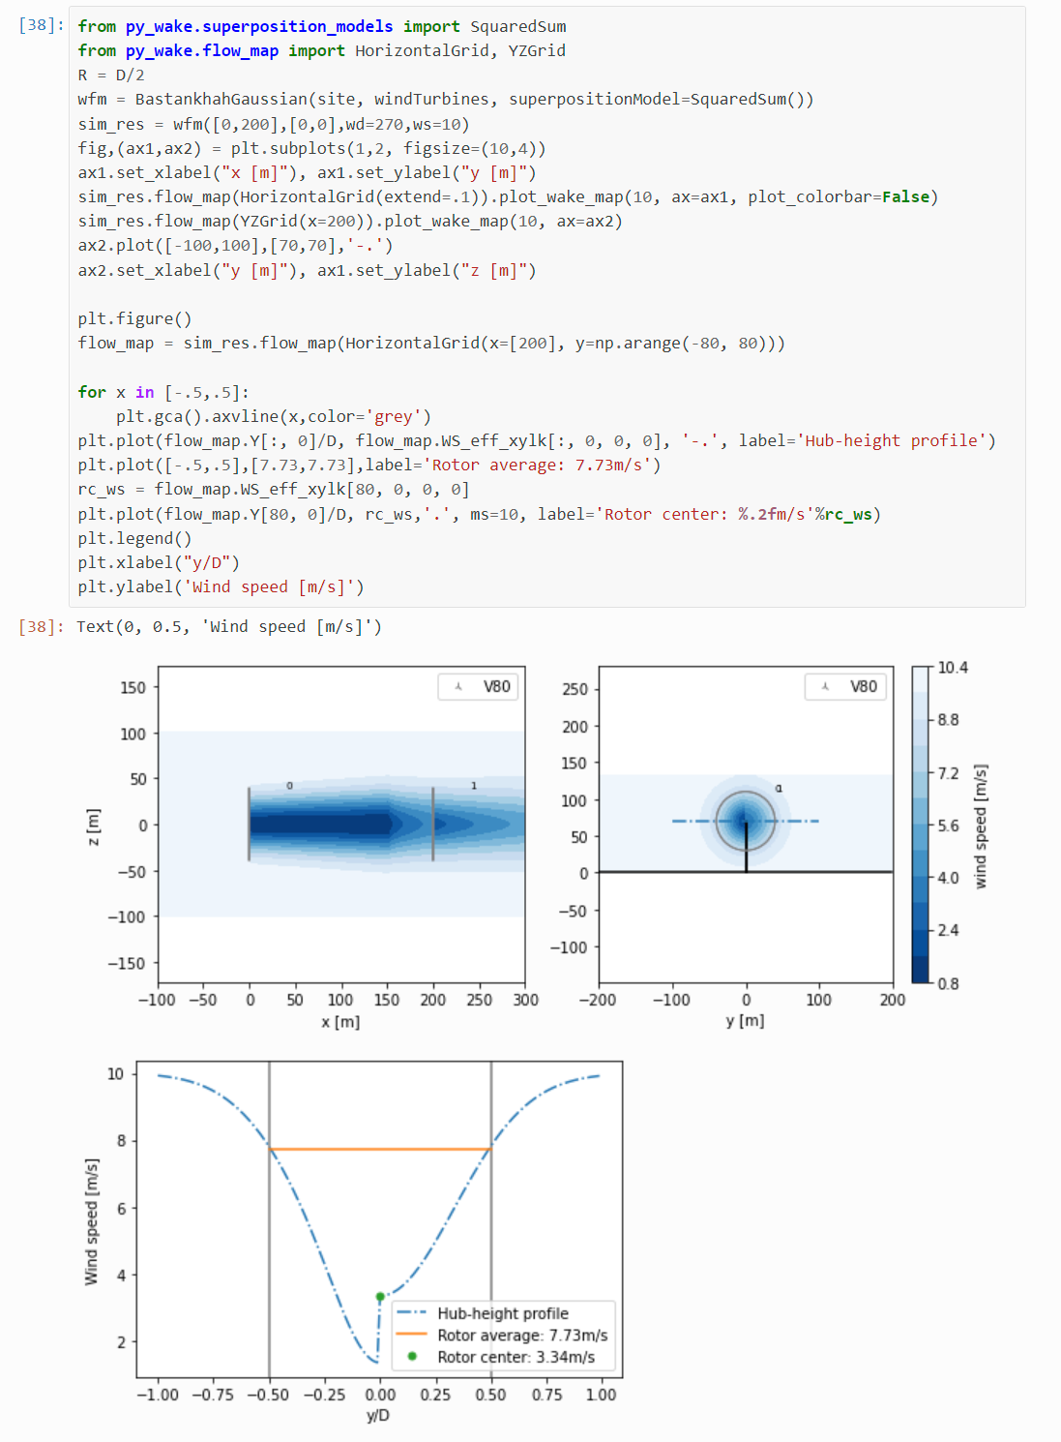
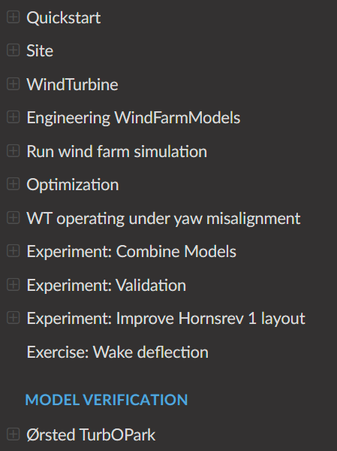
Potential Solutions –PyWake
PyWake is designed by MIT for DTU with open-source licensing from MIT, that can be used commercially
Well documented with extensive resources for modeling. Including windfarm models, wake deficit, superposition, blockage deficit, deflection, rotor-average etc.
Provides sample codes for each model as well as output
Provides detailed description as well as methods for customization, which is particularly helpful for creating user defined models
PyWake is developed in Python which have high efficiency and extensive library for data manipulation with Numpy, pandas, matplotlib

Slide 11
Chosen Solution - PyWake
Compared to OpenFAST, Floris, Ashes:
Pro:
Similar modularized design as OpenFAST for simpler implementation and testing
Python
More recent documentation
Has more models built into the software
Unlike Ashes it can be run on a Laptop
Con:
OpenFAST uses C++, faster compilation
Floris includes more complicated models such as heterogeneous inflow in 3 dimensions
Ashes provides Real time 3D visualizations of data
Internal Integration within BP
BP's own optimization team for offshore wind farms uses PyWake as their internal optimization tool
BP's optimization specialist Mark joins our weekly sponsor meeting which provides necessary help for us to build this software

Slide 12
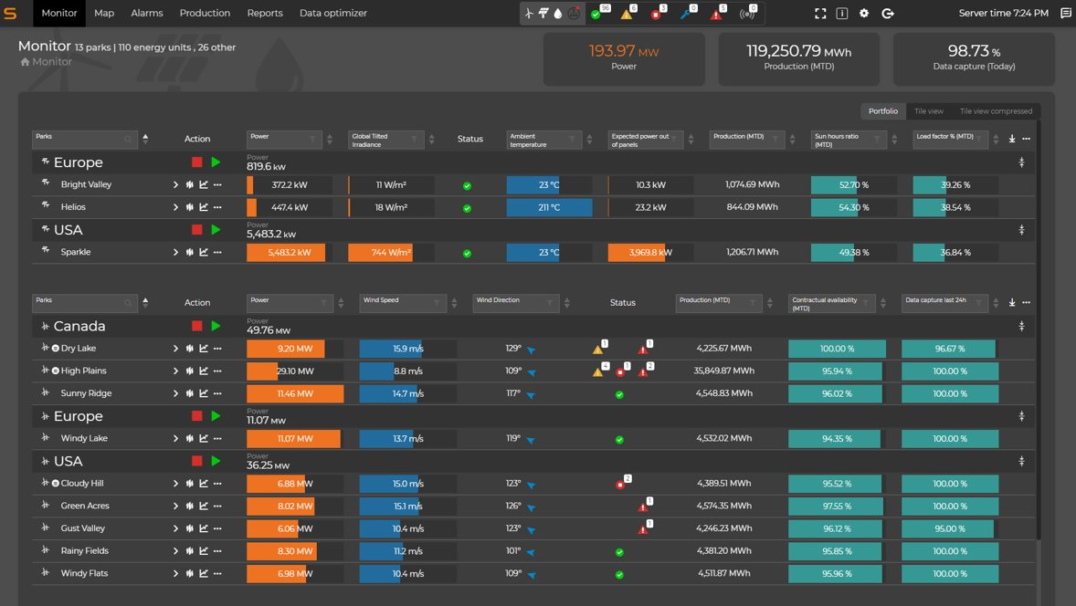
Design Approach
Determine Inputs & Outputs
Create GUI to allow the user to input data
bp has access to the data that their windmills output, but they do not have a program to analyze the data
Display outputs on GUI
Time permitting – start to optimize windmill locations
Image given to us by bp

Slide 13
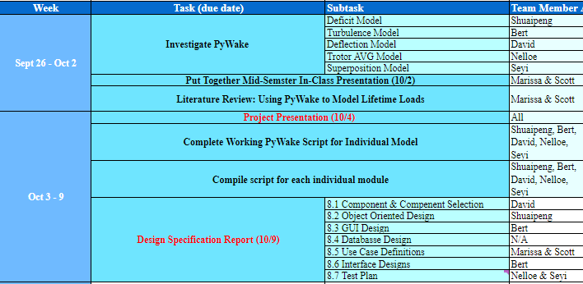
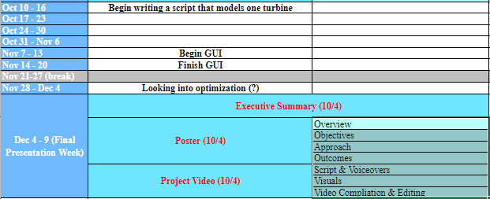
Project Plan

Slide 14
Thank you!

